Slide 1
American Fertility Center Irvine, CA
Dr, Rafif Mousa, MD, MSc

Slide 2
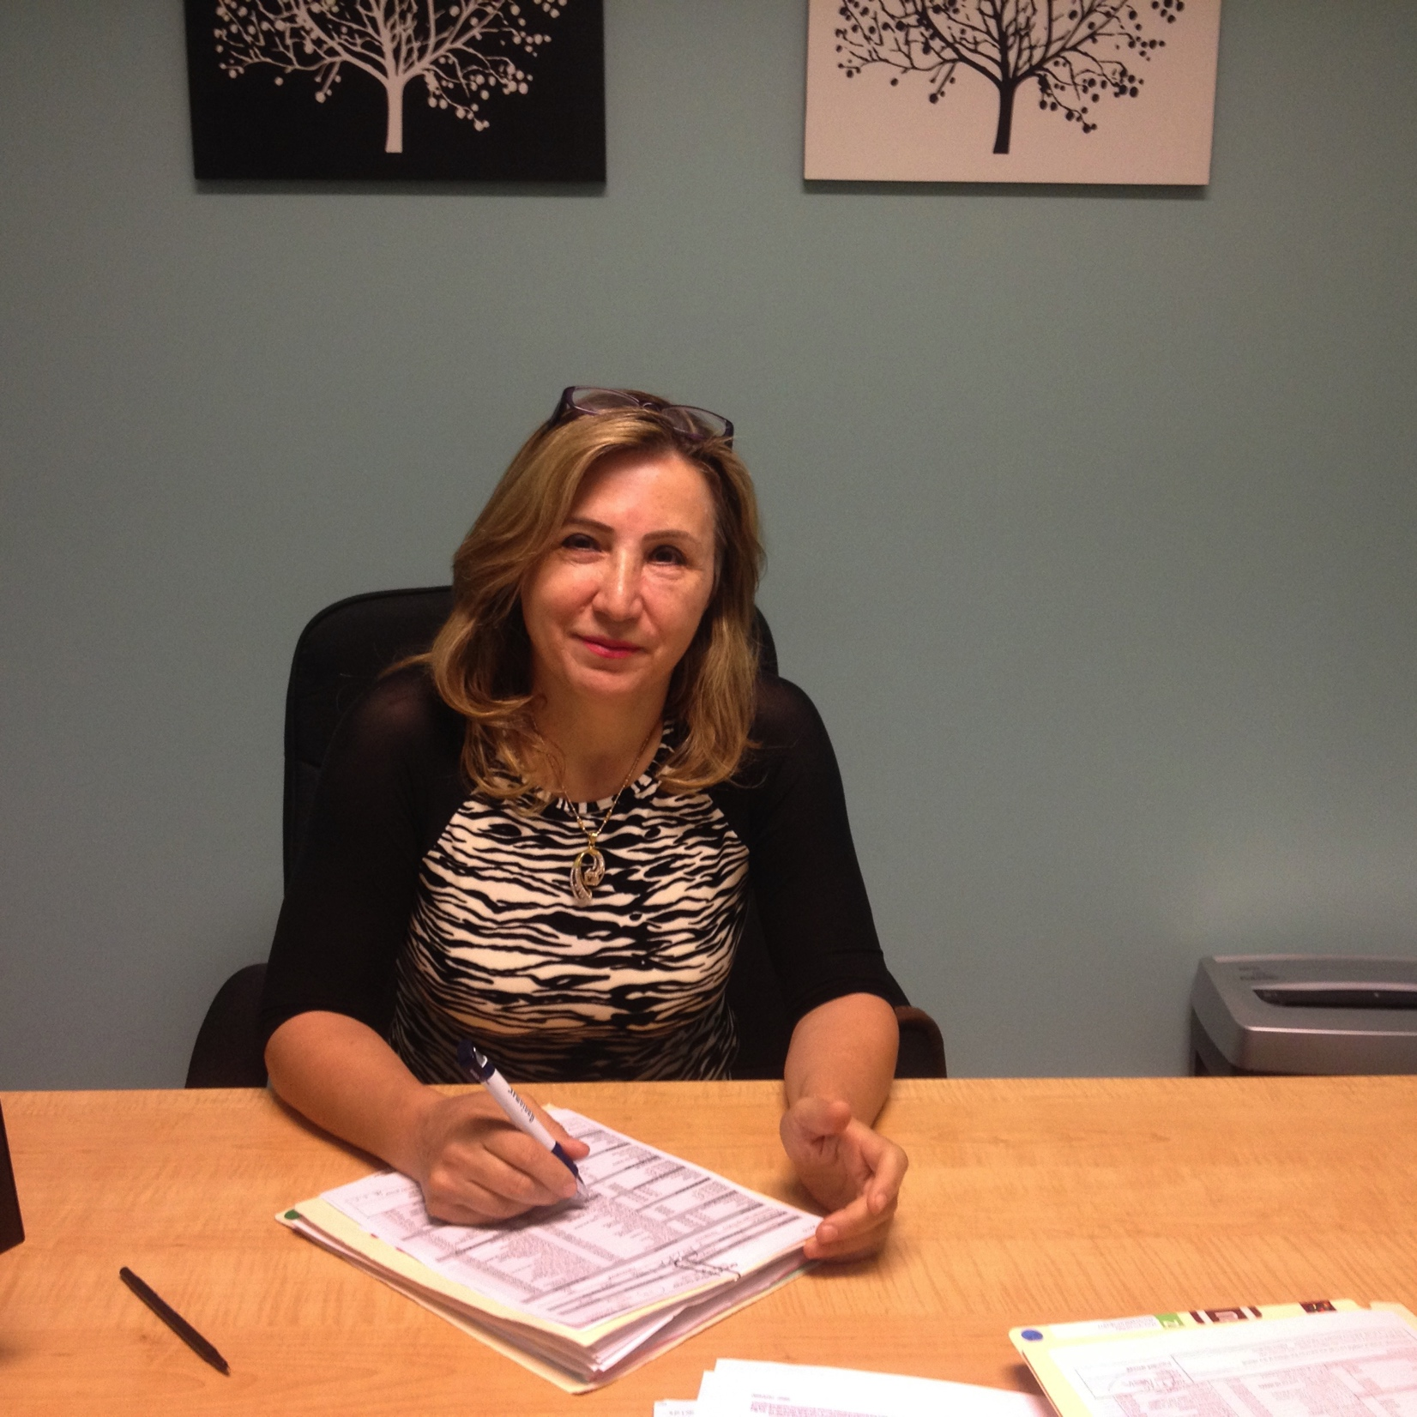
Rafif Mousa, MD, MSc
a Reproductive Endocrinology and Infertility specialist who practices with a philosophy of providing the highest quality treatment of couples with fertility problems in a professional and caring environment.

Slide 3
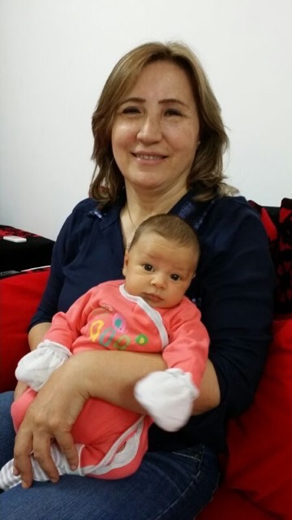
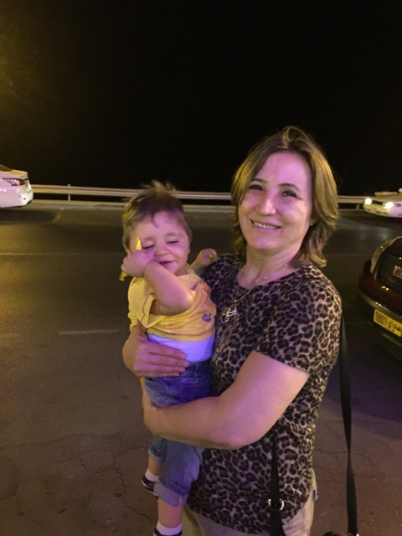
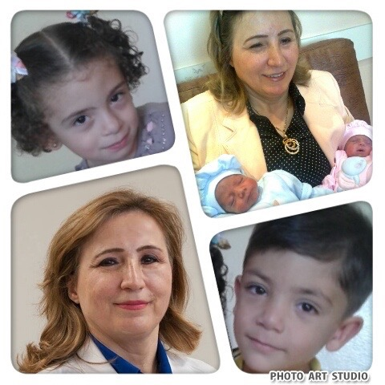
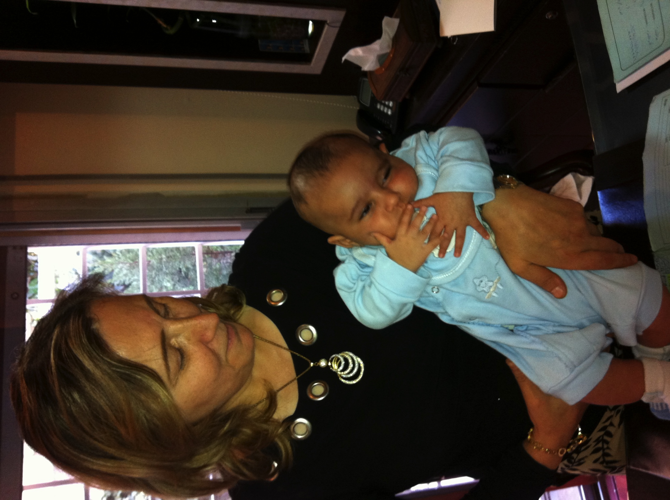
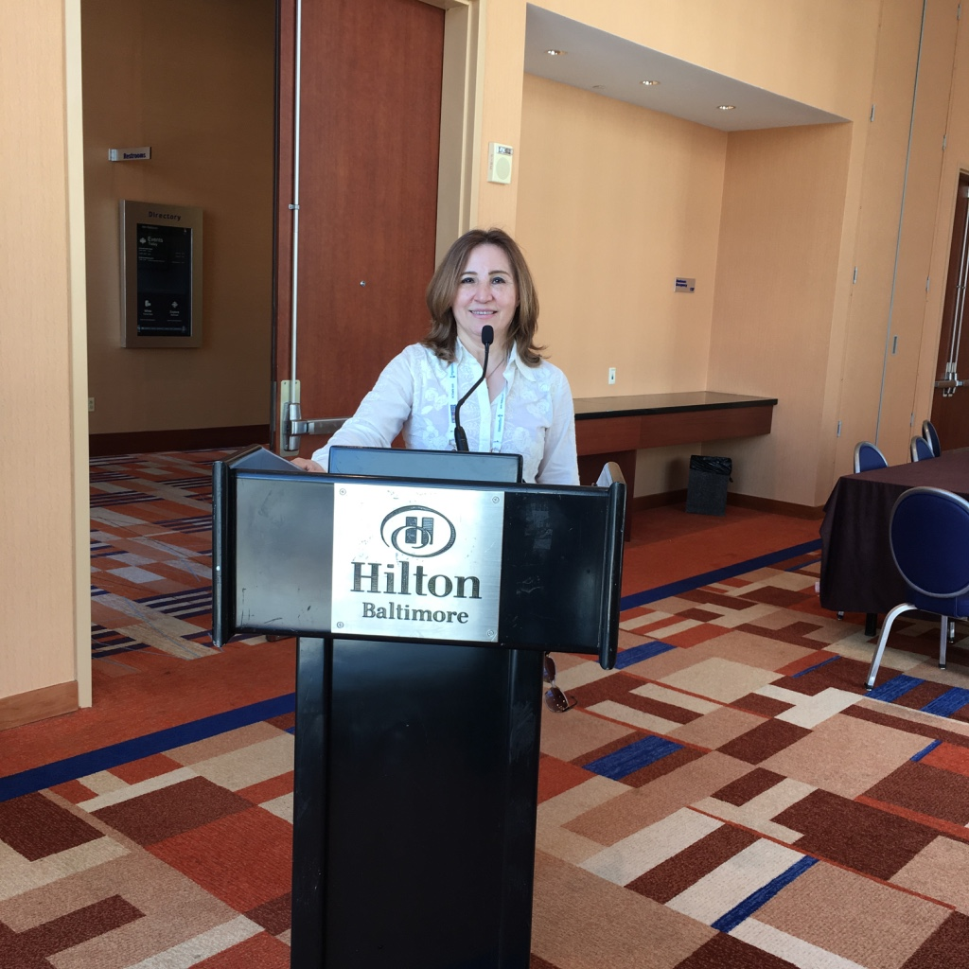
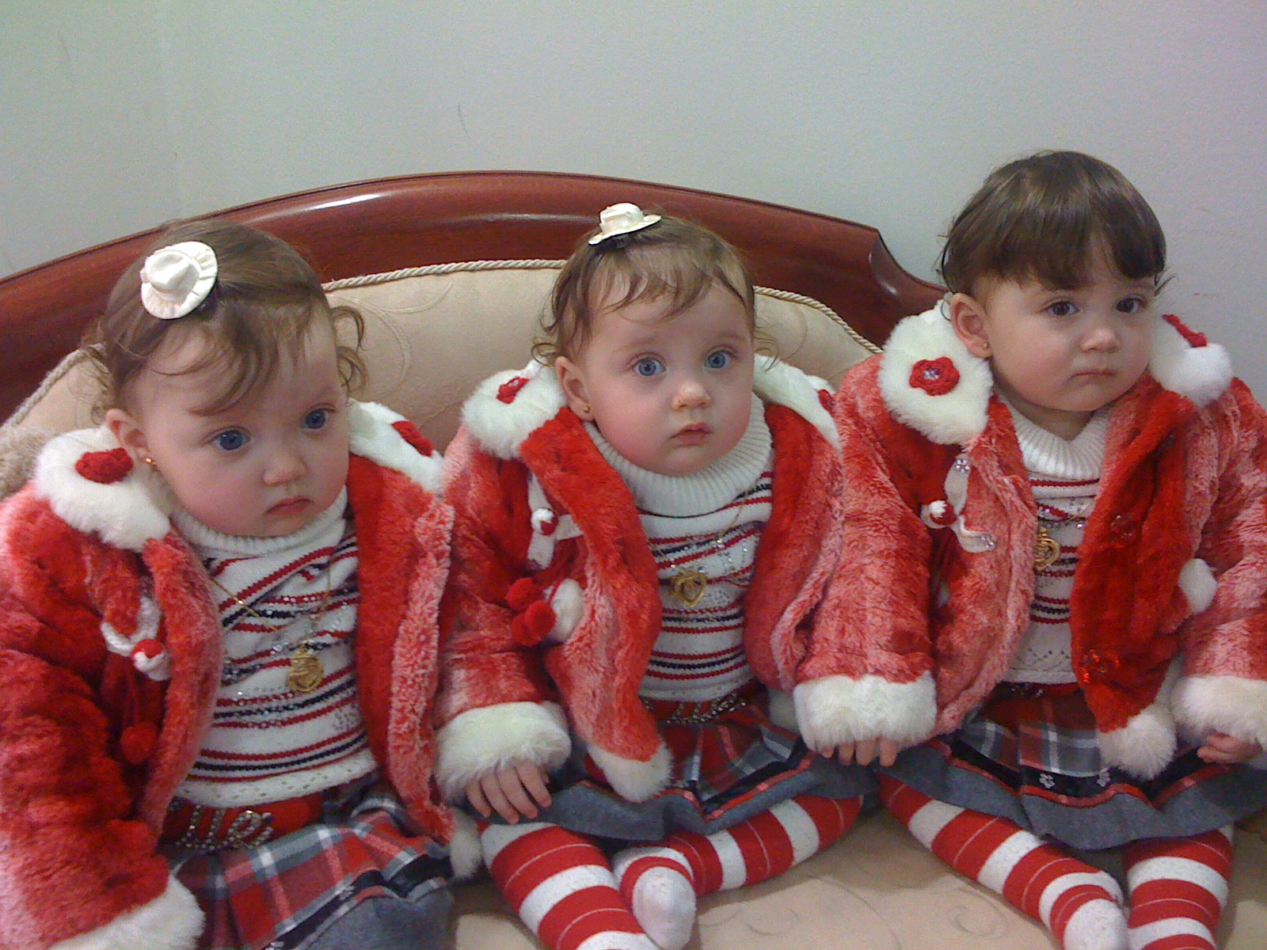
Dr. Mousa builds very good relations with her patients, paying attention to small details that gives them a feeling of comfort , assurance and trust.

Slide 4
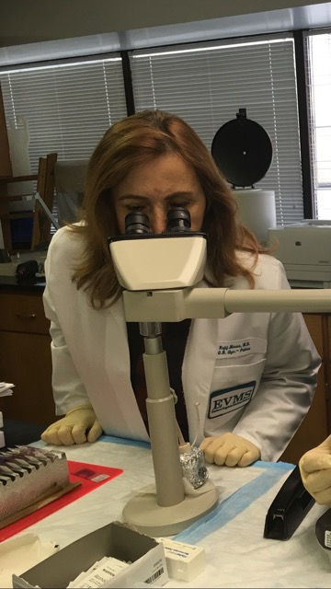
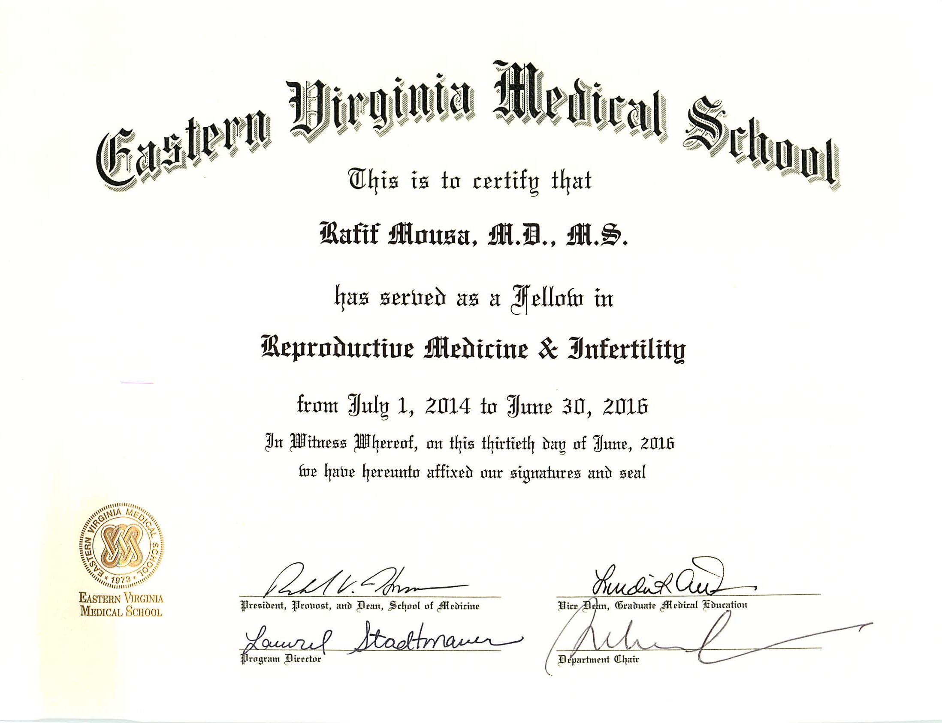
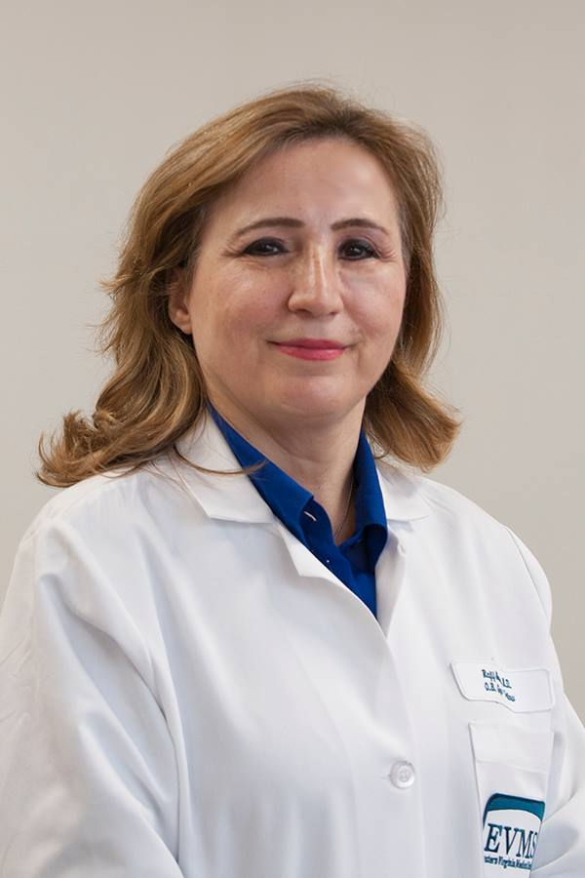
Fellowship..
Dr. Rafif Mousa
graduated from Eastern Virginia Medical School EVMS (Jones Institute, the birthplace of "baby-tube" in the US,) where she completed her clinical

Slide 5
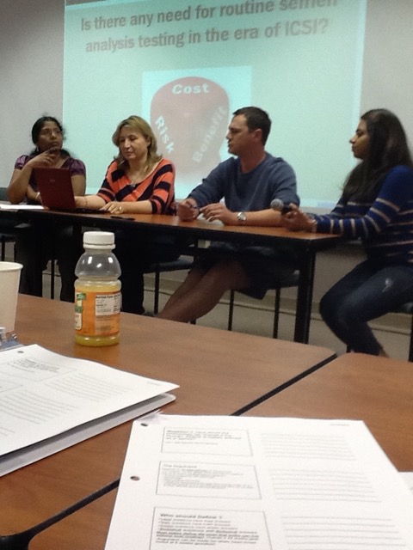
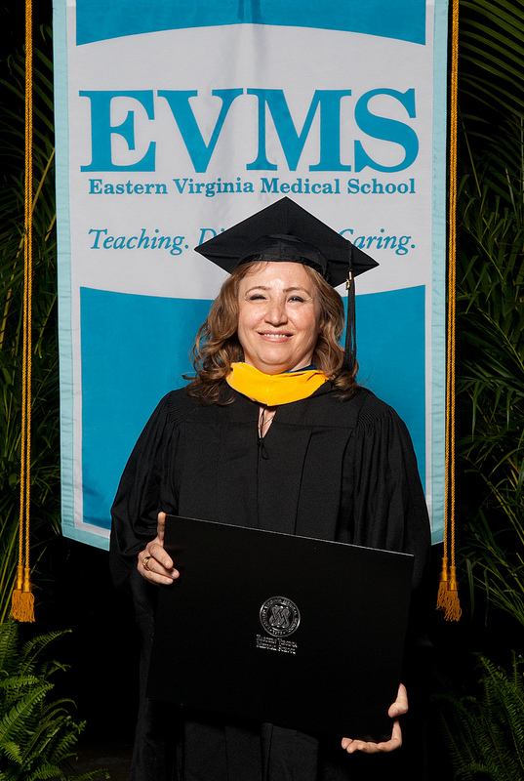
Master Degree in “Clinical Embryology and Andrology
In parallel, Dr.Mousa went academics and earned a master degree in “Lab work of IVF” at EVMS.
This gave her a deep understanding of both the clinical aspect and the lab details of IVF.
This is a great combination that only very few physicians have.

Slide 6
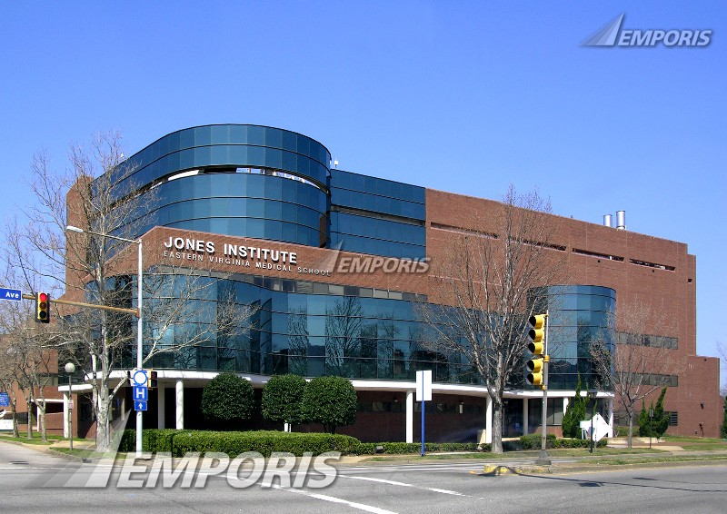
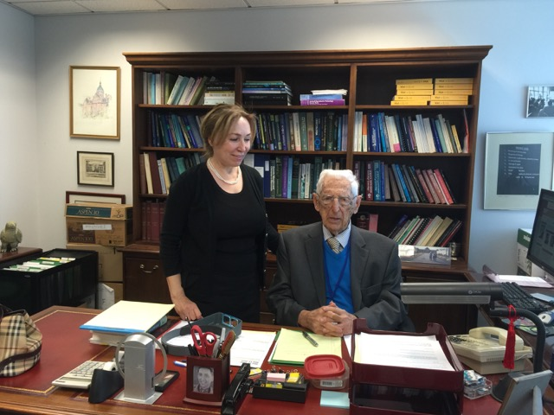
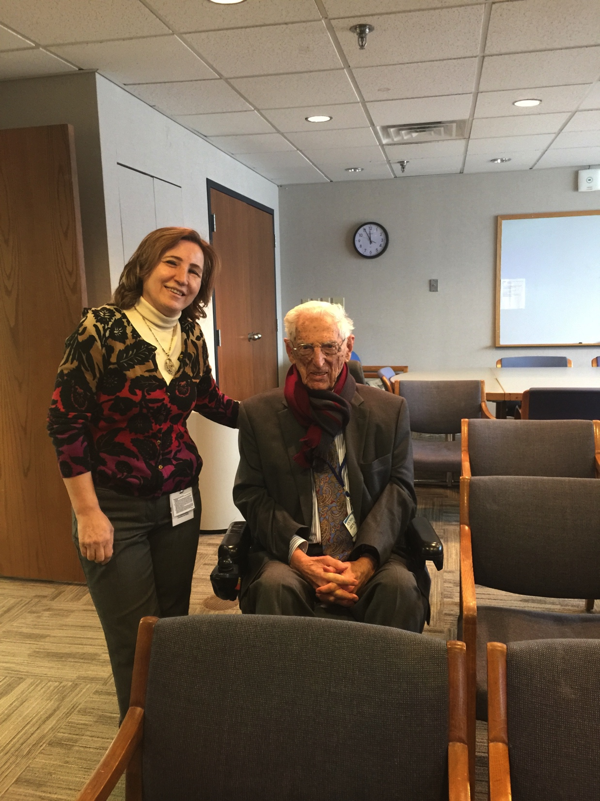
Jones Institute, the birthplace of "baby-tube" in the US,) where she is honored to complete her clinical fellowship with Dr. Howard Jones.

Slide 7
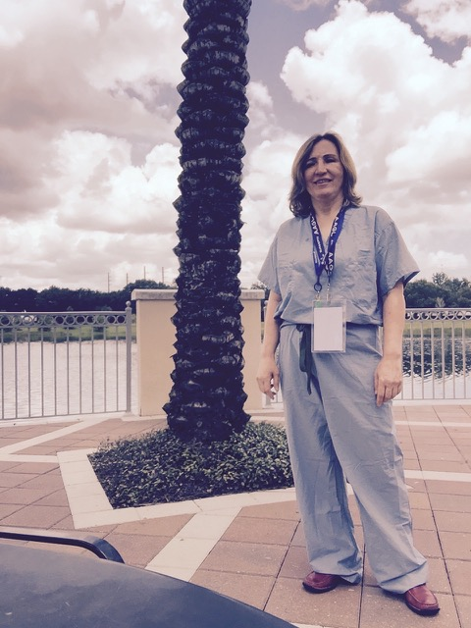
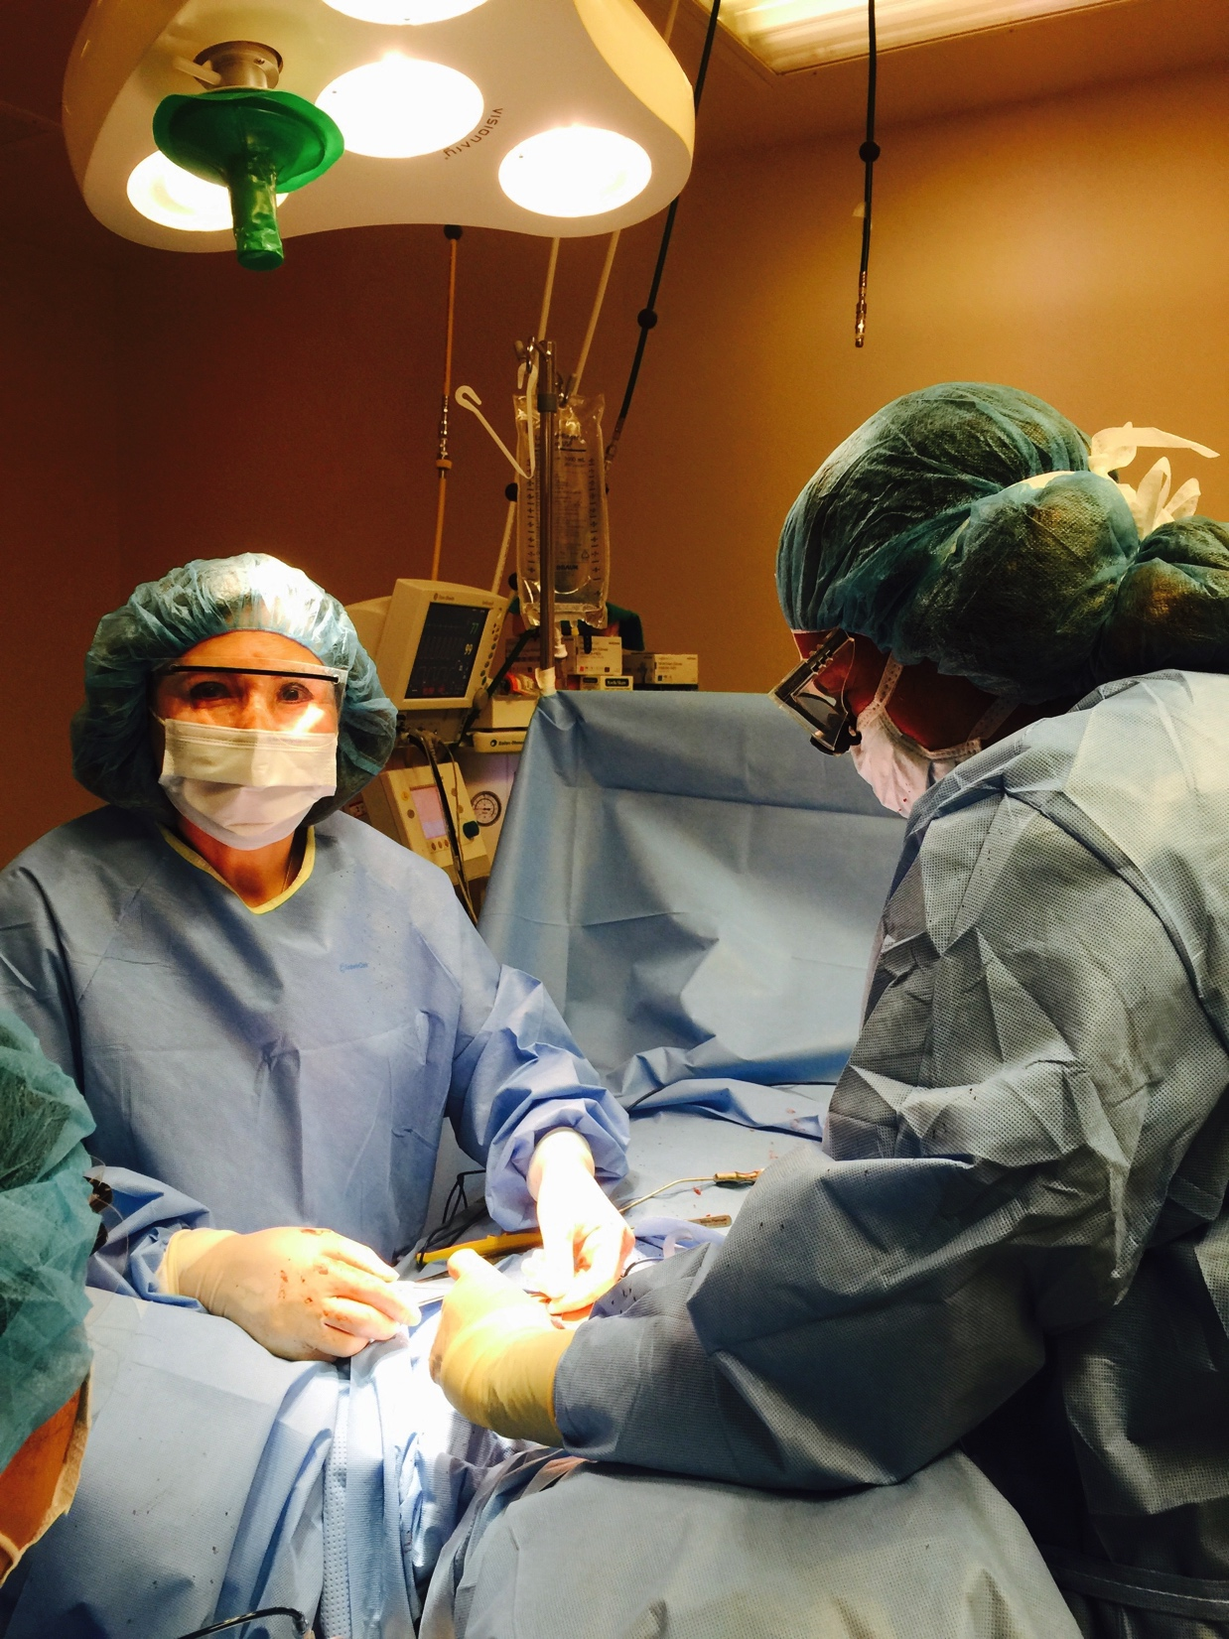
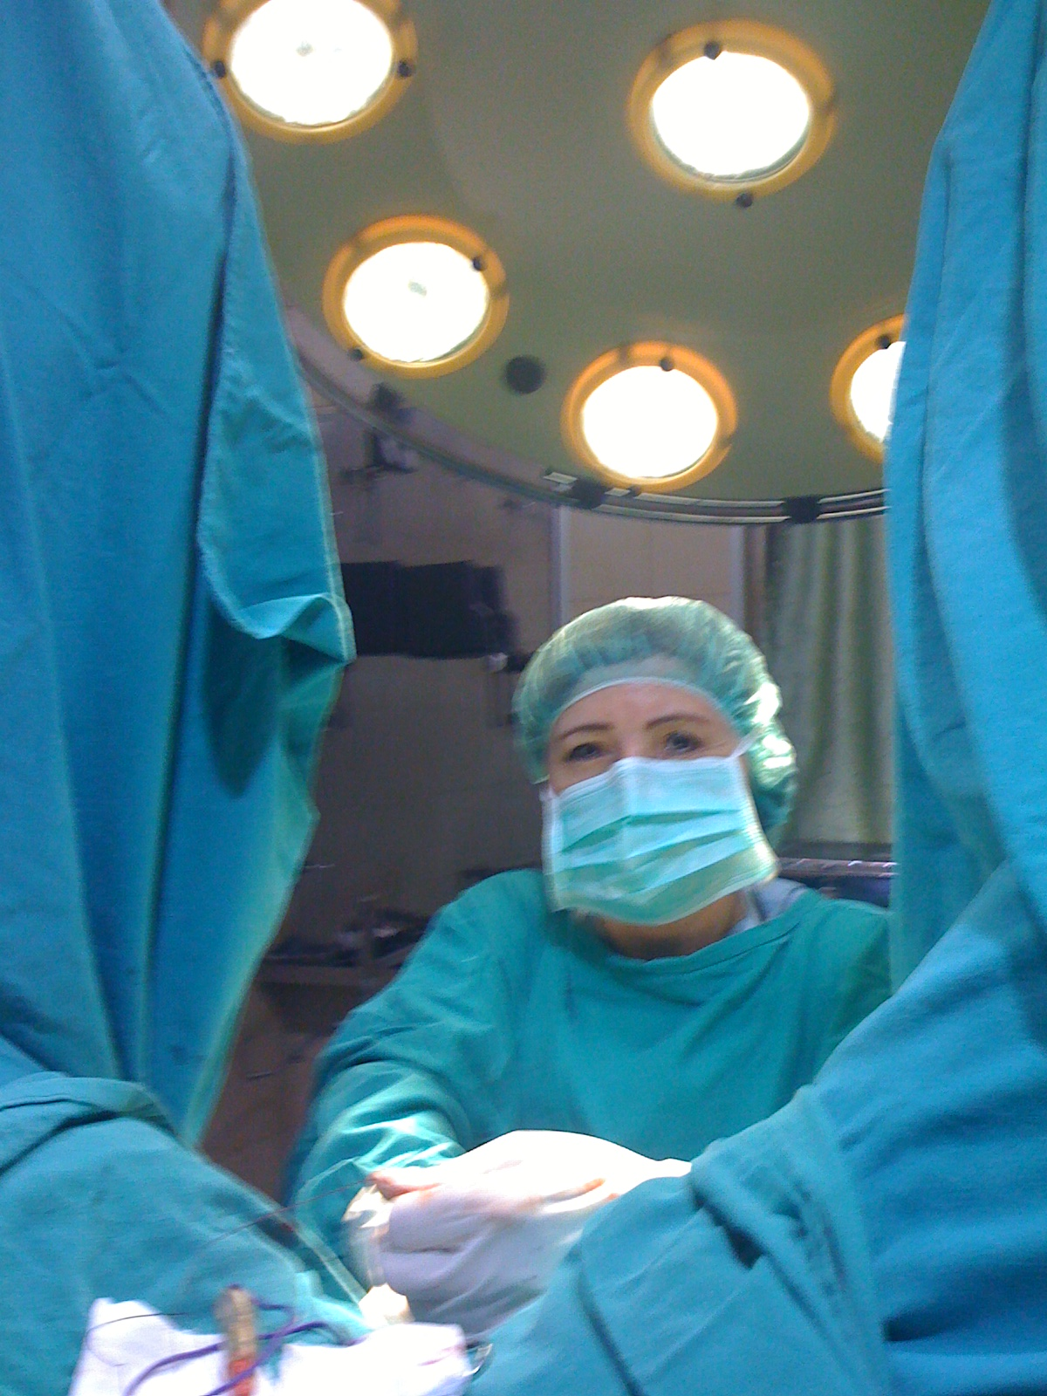
Dr. Mousa is focused on management for high complex infertility cases. She has a track of high success rate in pregnancy and has extensive experience in complex endoscopic and robotic surgery.

Slide 8
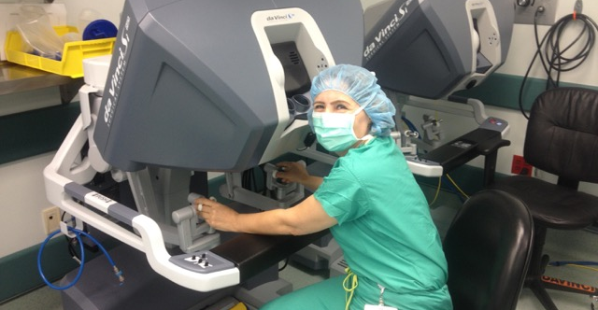
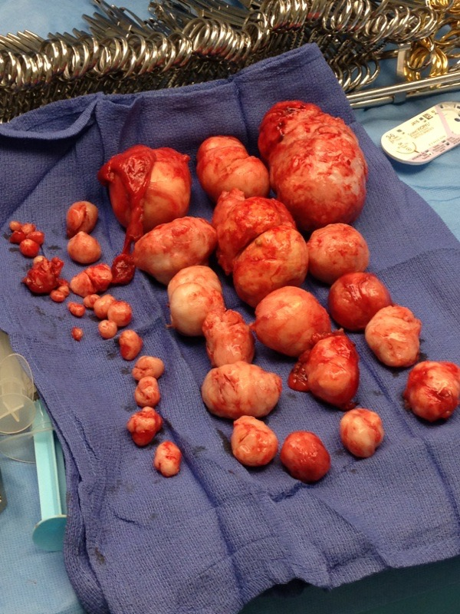
Dr. Mousa is expert in Robotic surgery: Da Vinci .

Slide 9
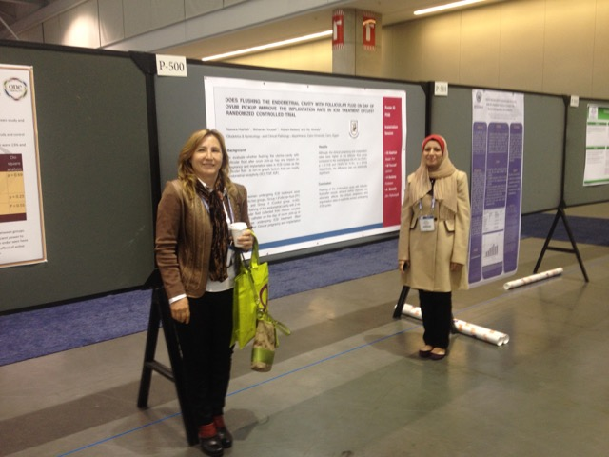
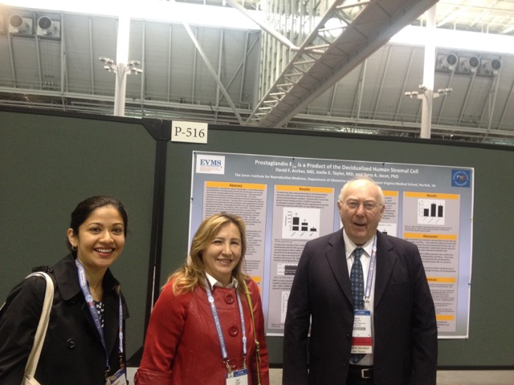
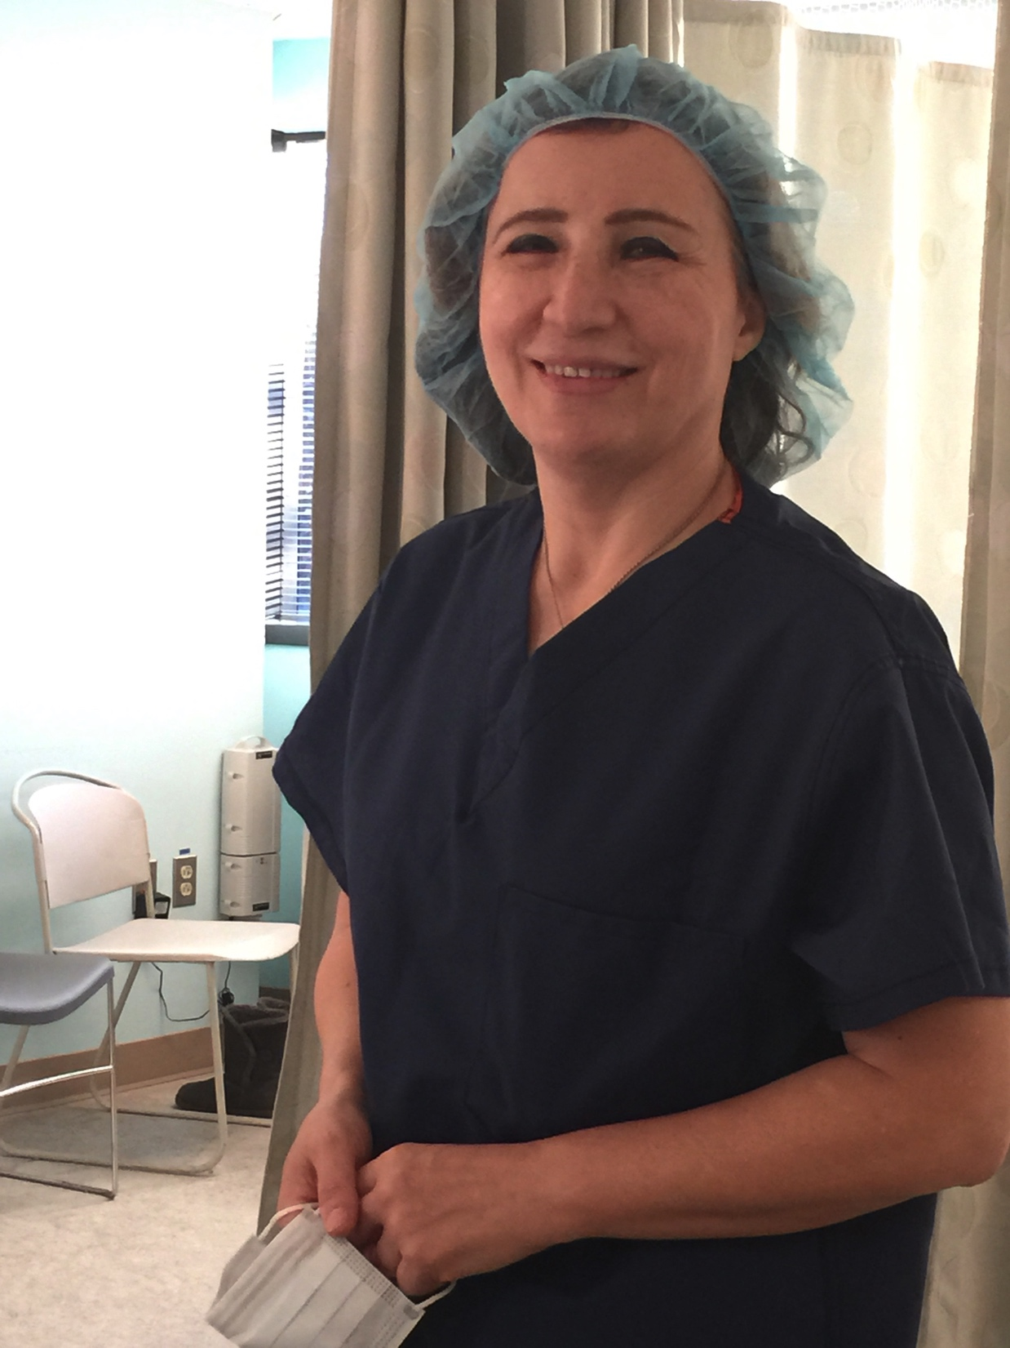
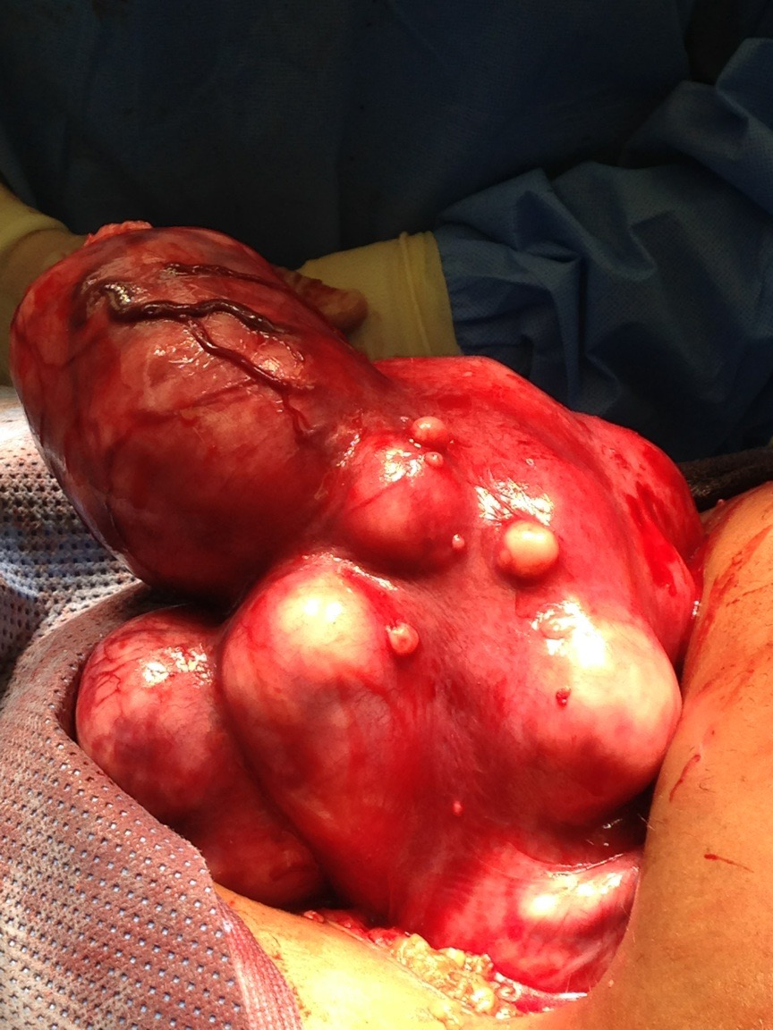
Research
Dr. Mousa has long history in research in subjects related to reproductive medicine. Her main field of interest is Male factor, uterine fibroids and poor ovarian response

Slide 10
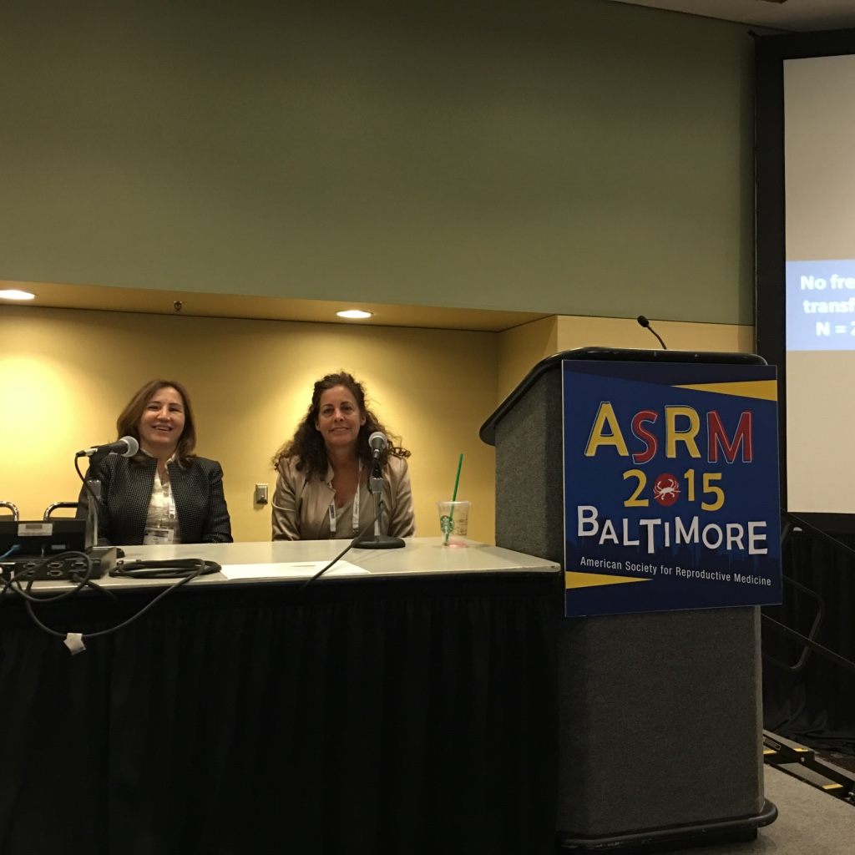
A recognized member of ASRM

Slide 11
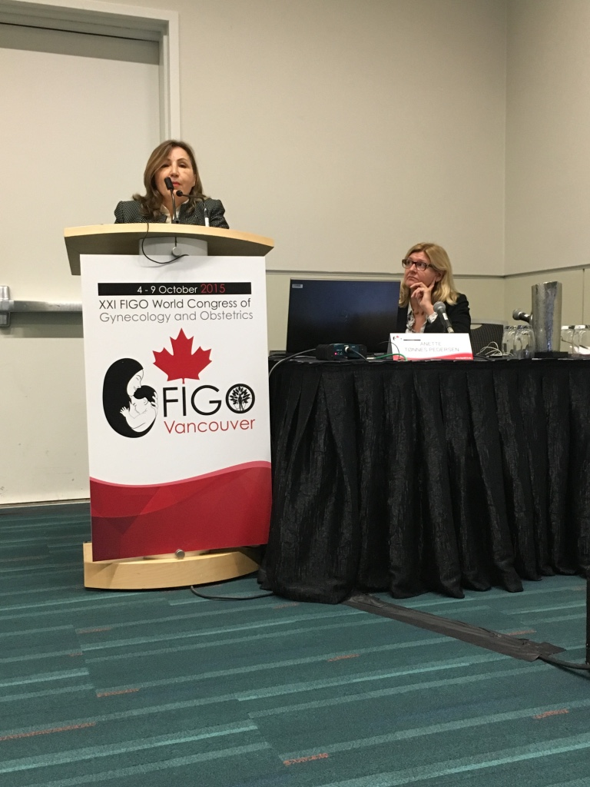
Dr Mousa, used to be a well known international figure who worked in the fertility fields for long years. She used to lecture in middle east area.
A member of FIGO

Slide 12
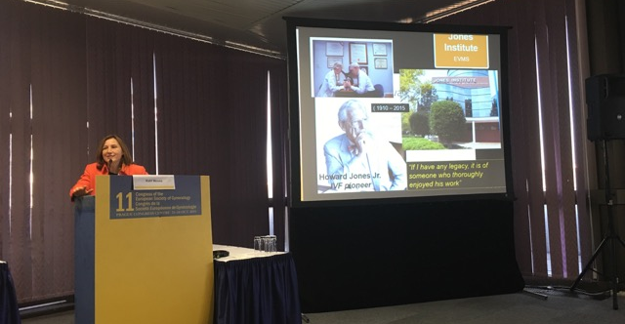
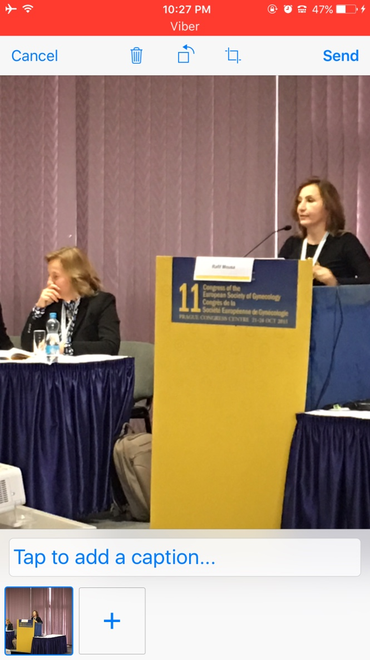
a member of Eurobian Gynecologic society.

Slide 13
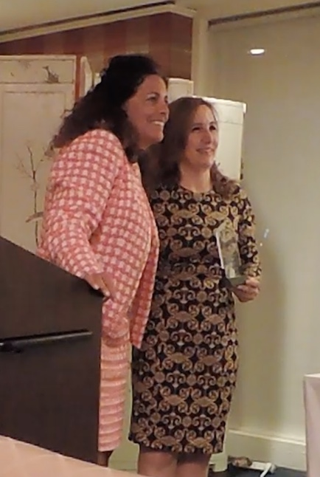
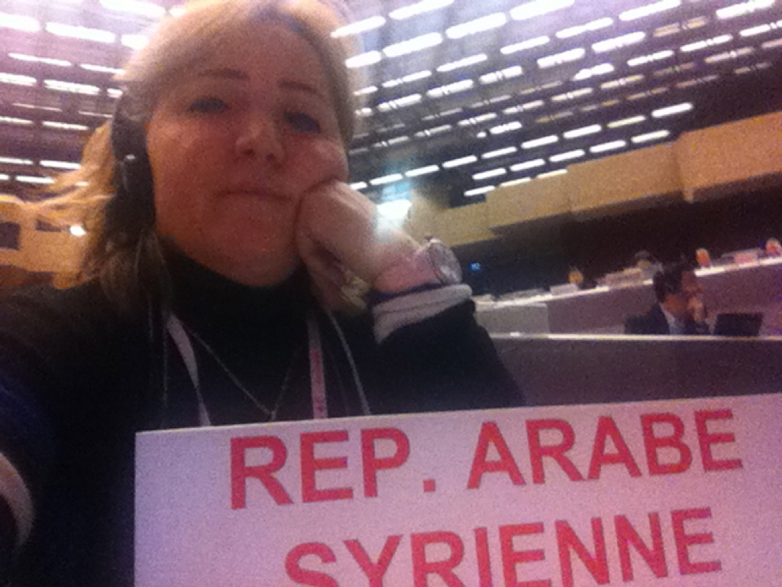
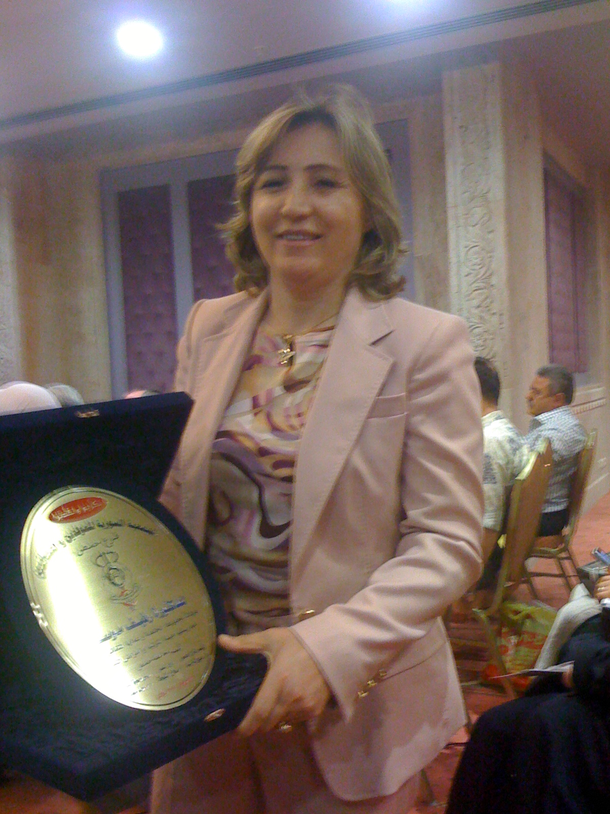
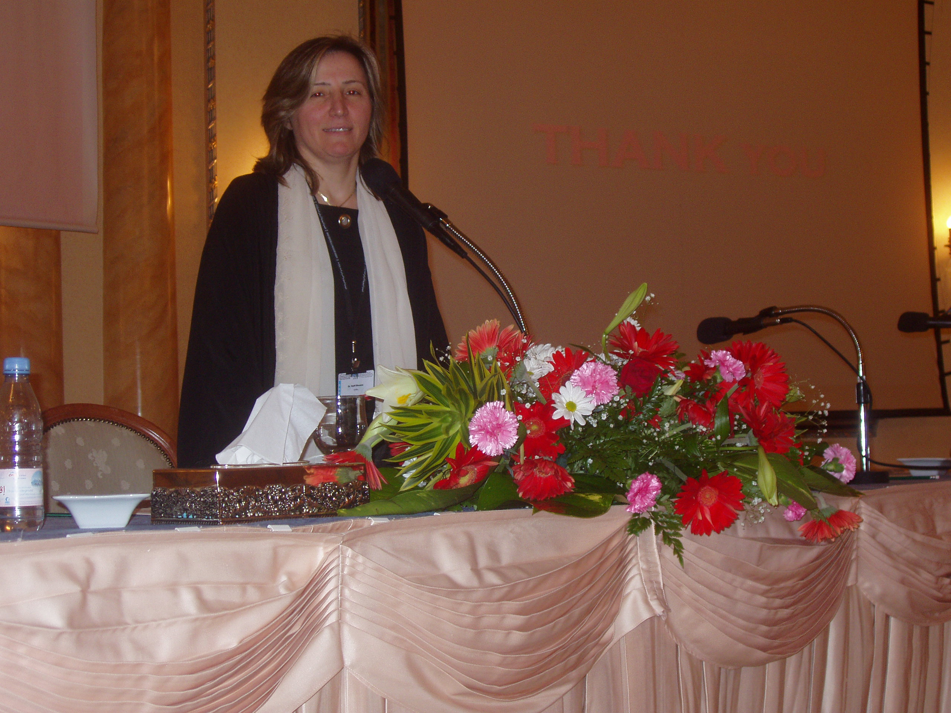
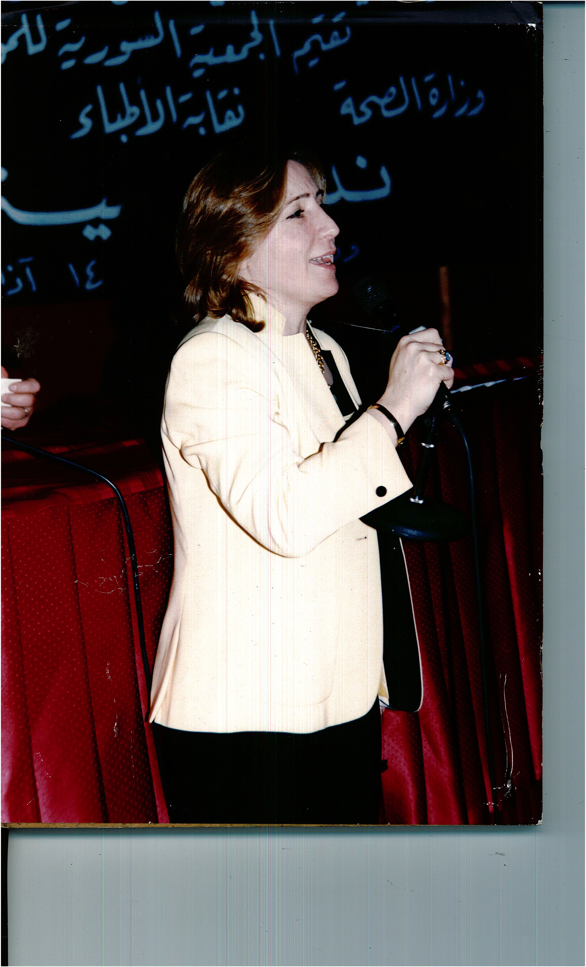
Awards

Slide 14
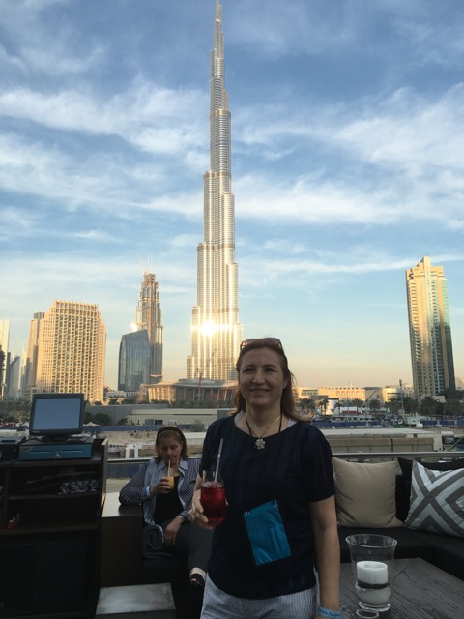
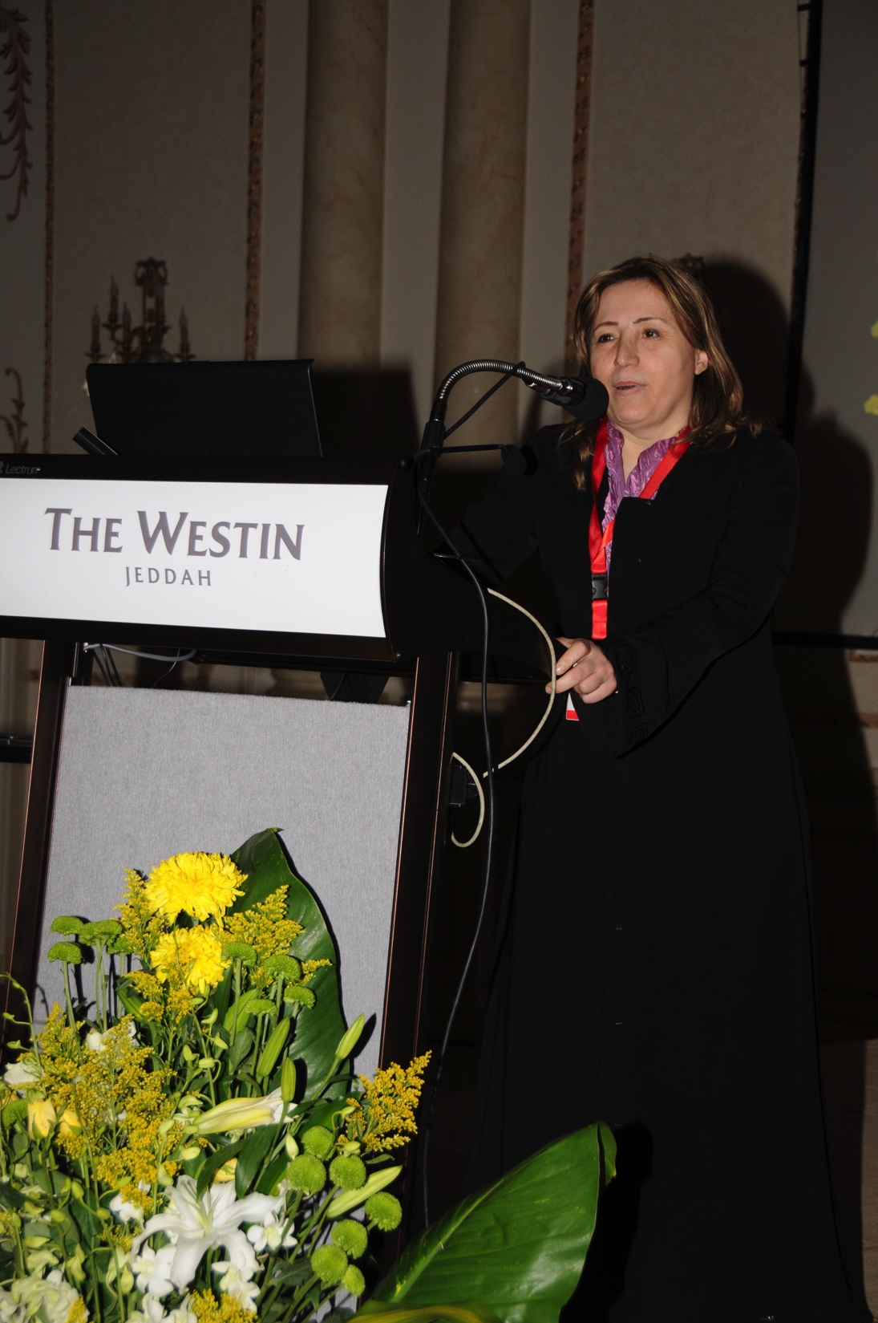
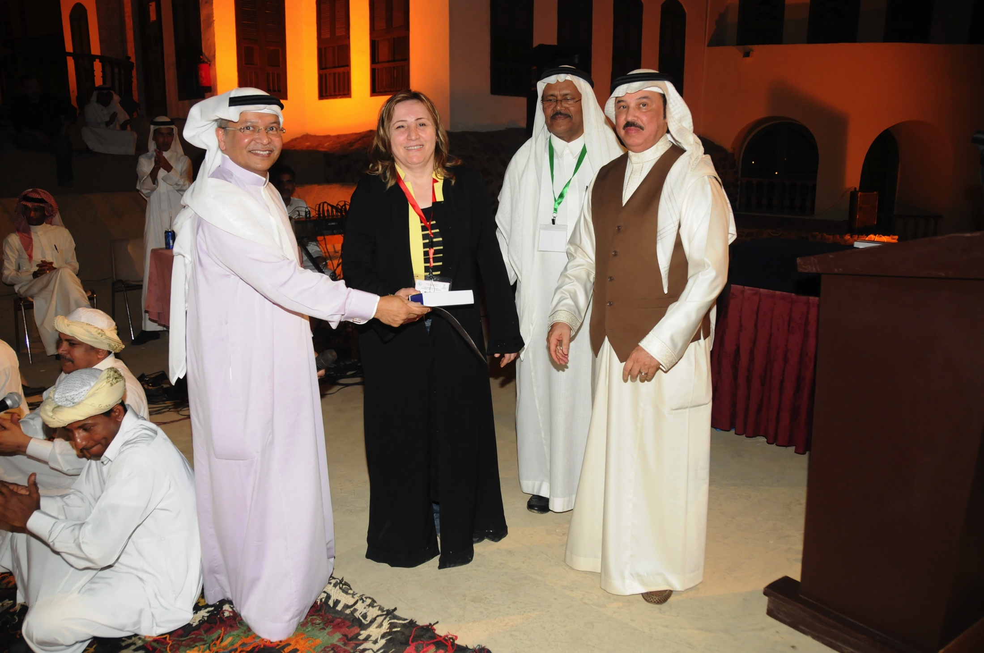
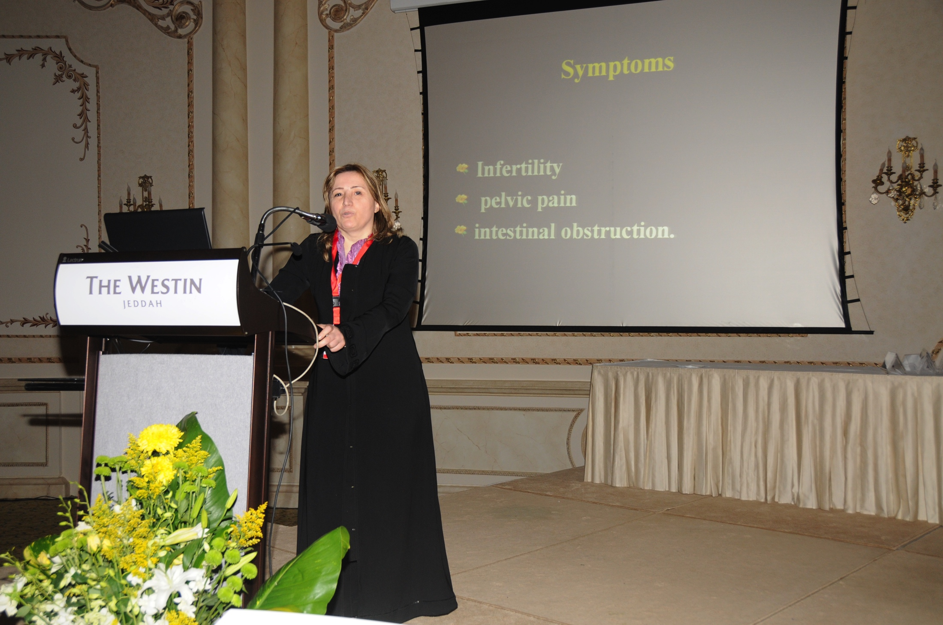
Dr. Mousa is consultant in reproductive medicine in the Arab Gulf Area, where she is frequently invited to manage complicated infertility cases.

Slide 15
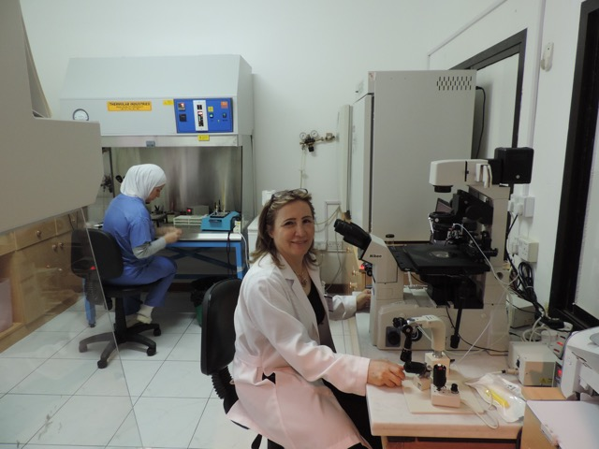
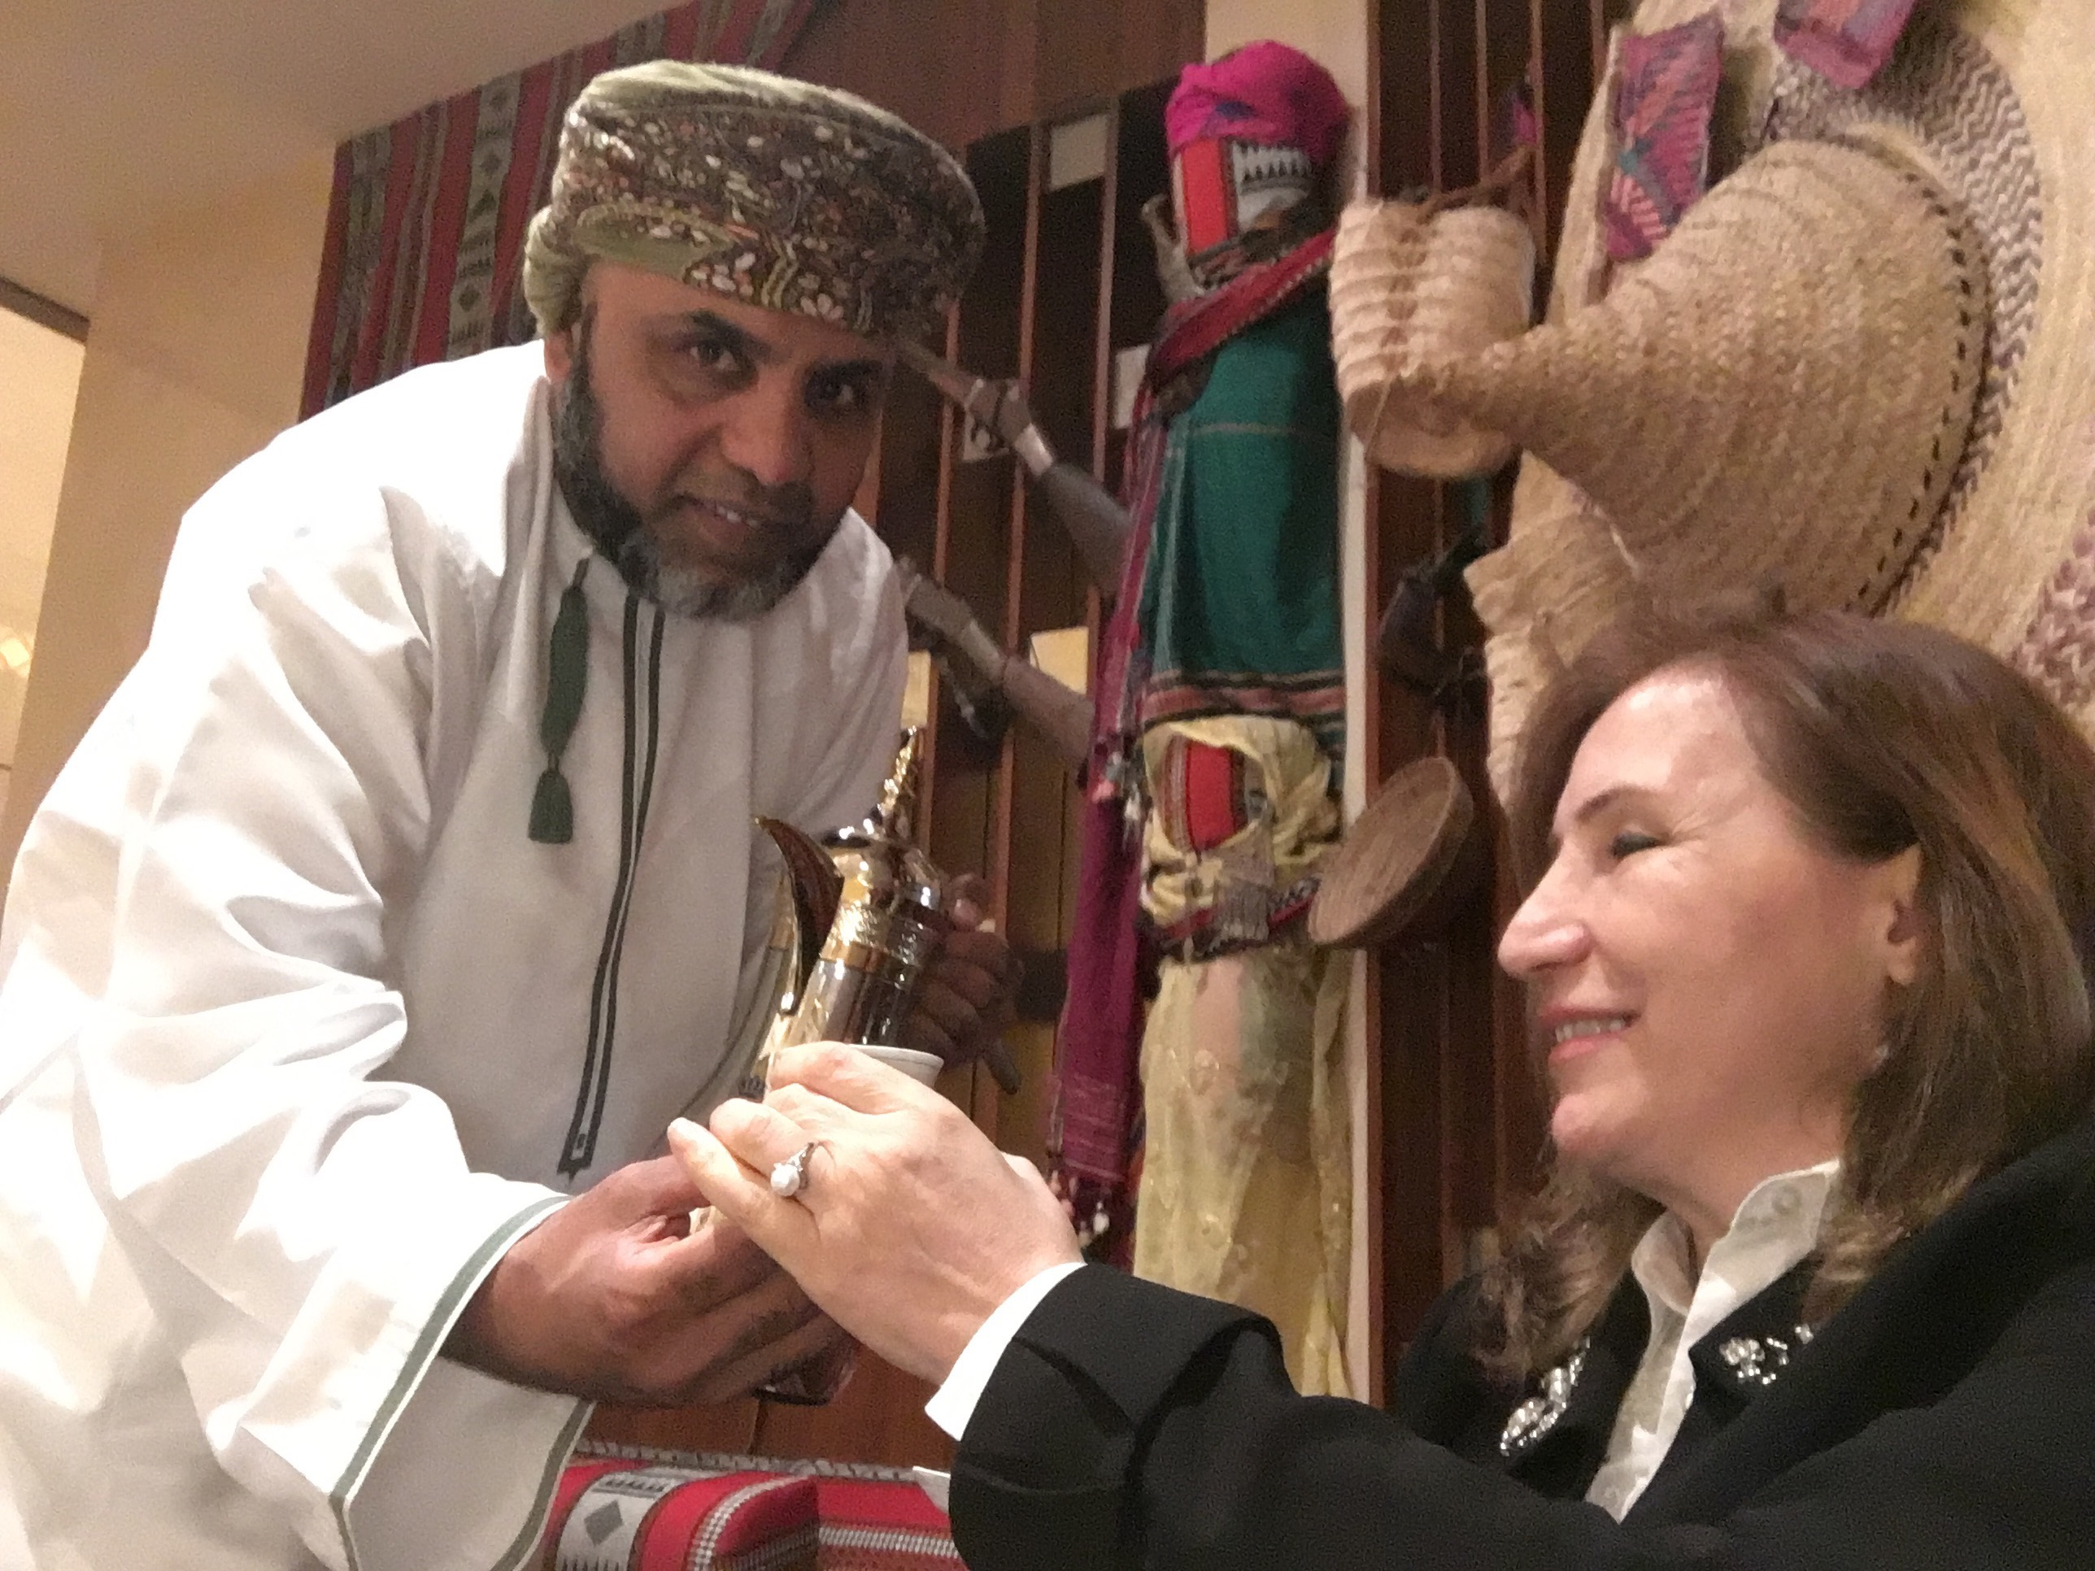
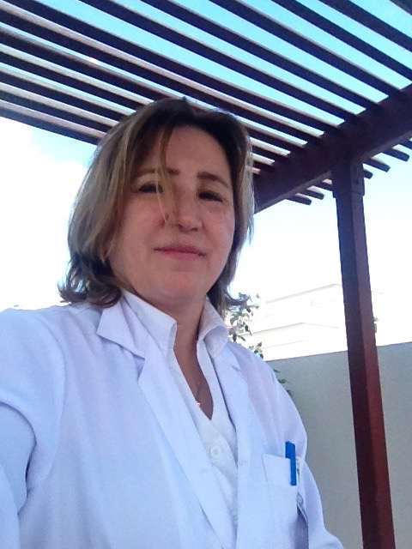
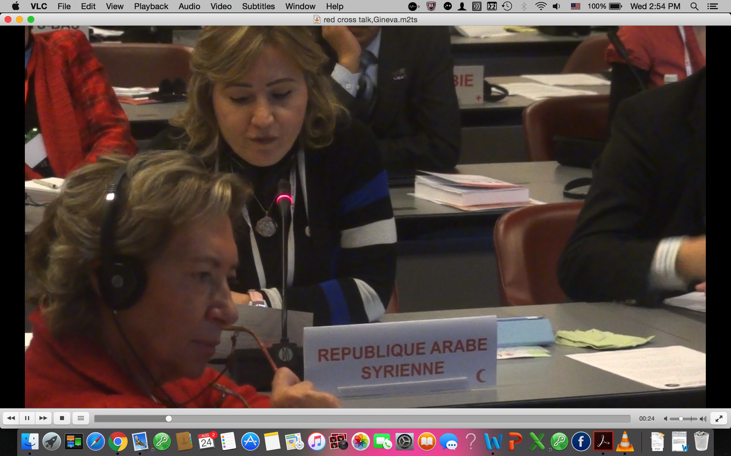
Dr Mousa, used to be a well known international figure who worked in the fertility fields for long years. She used to lecture in middle east area.

Slide 16
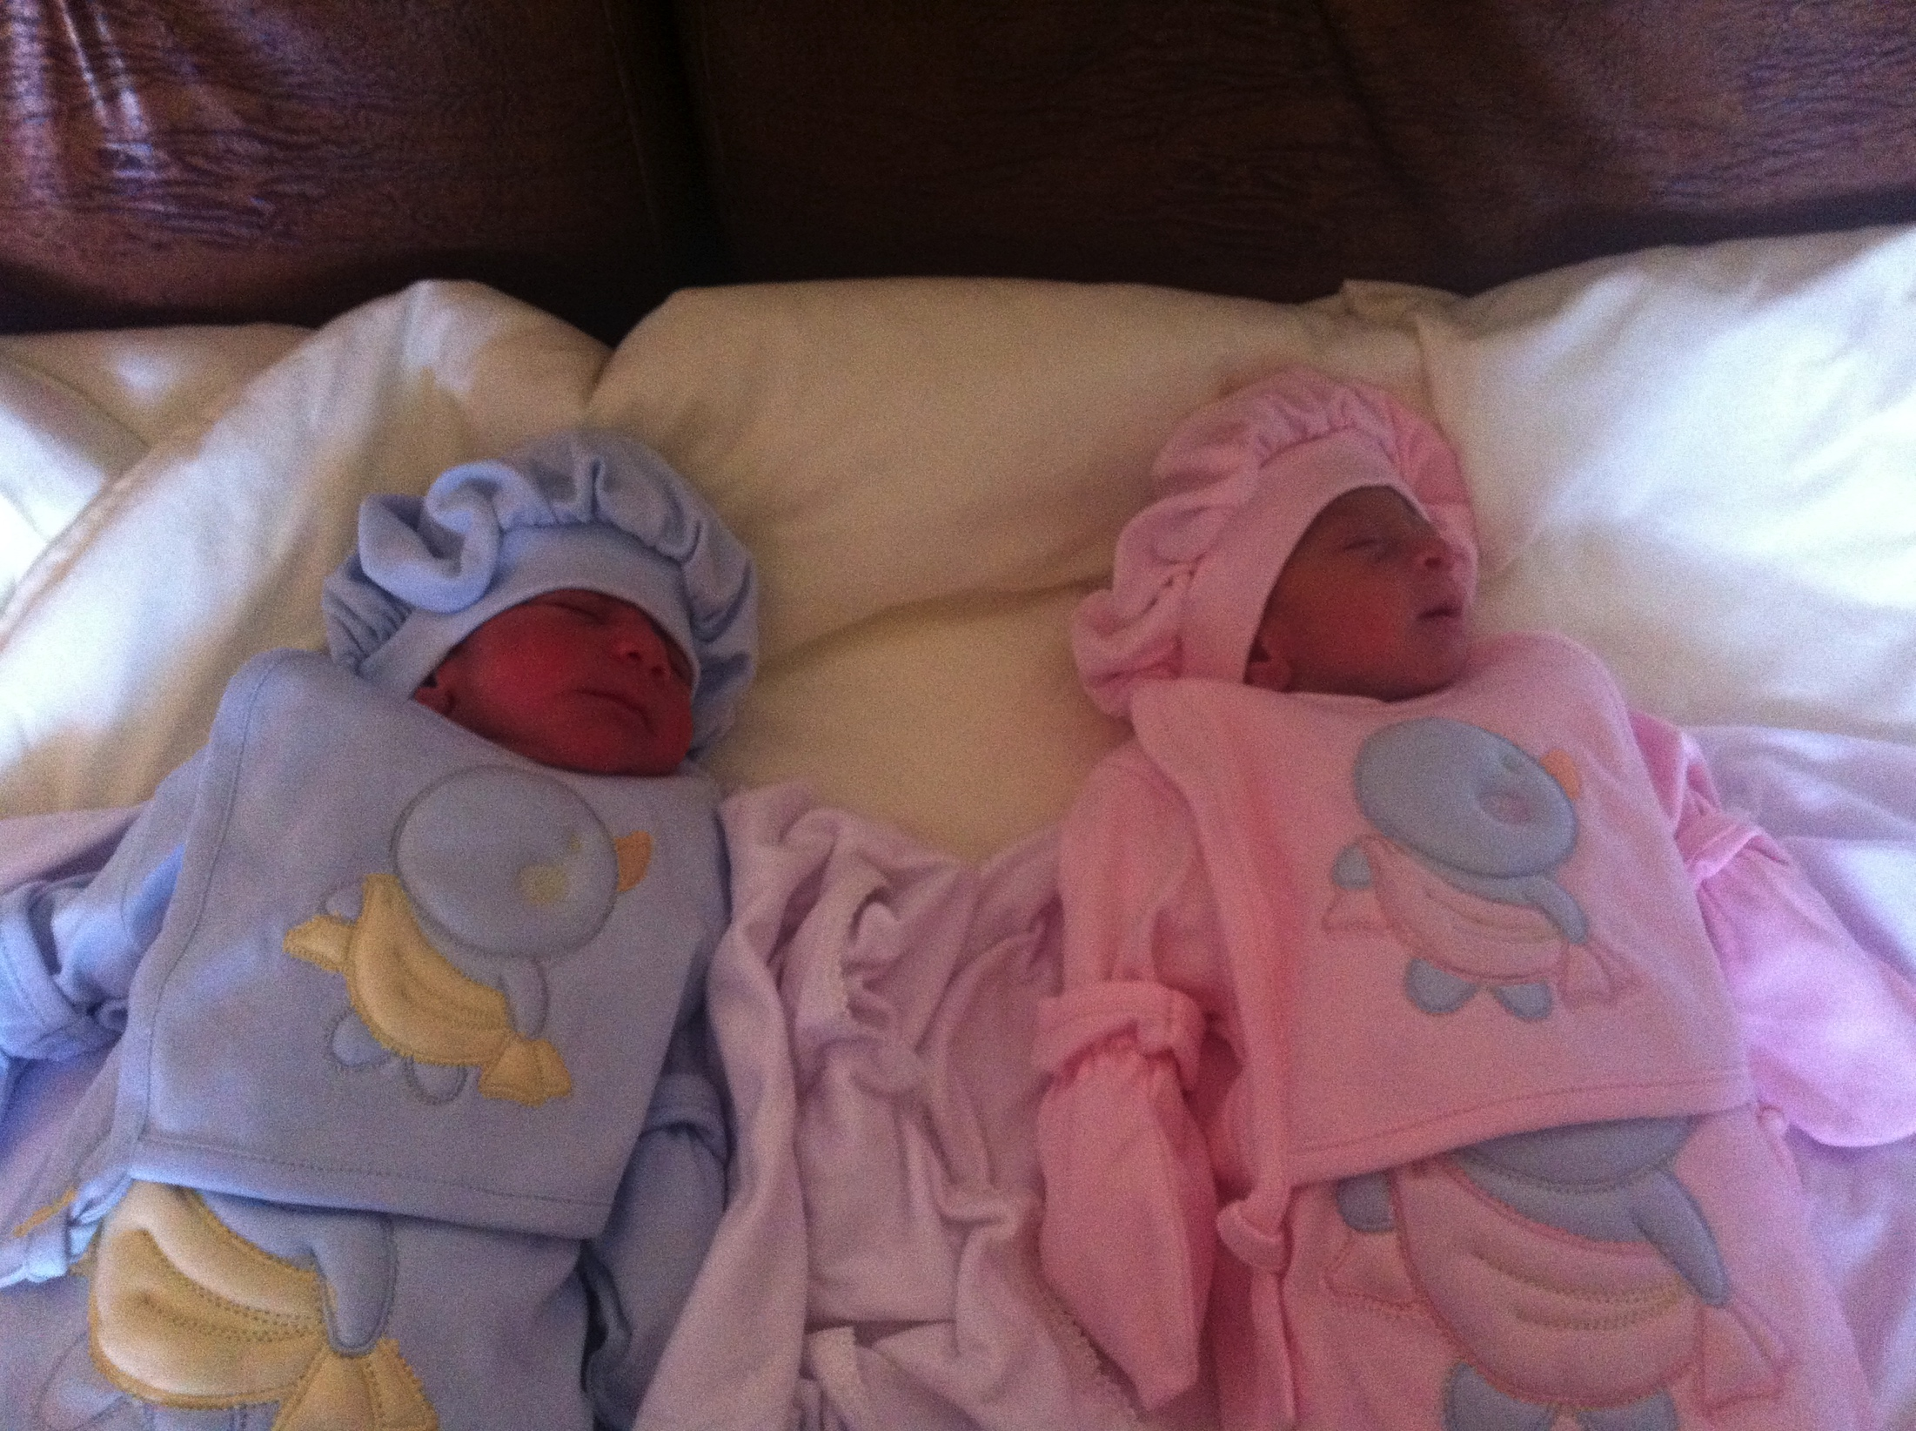
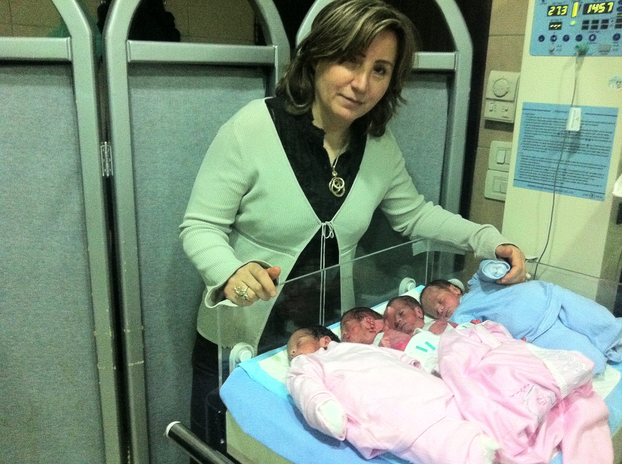
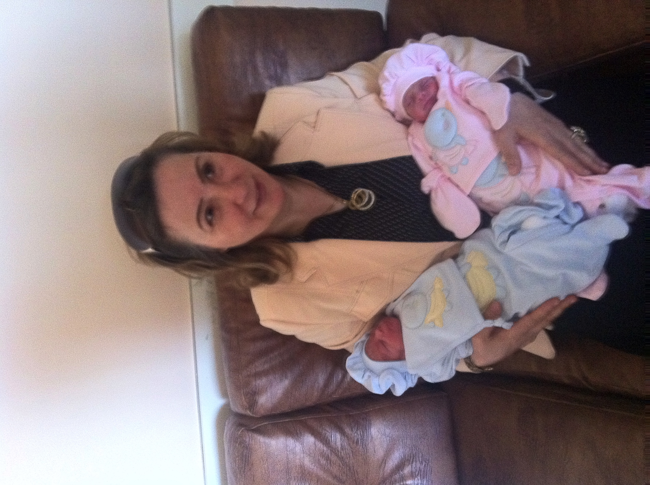
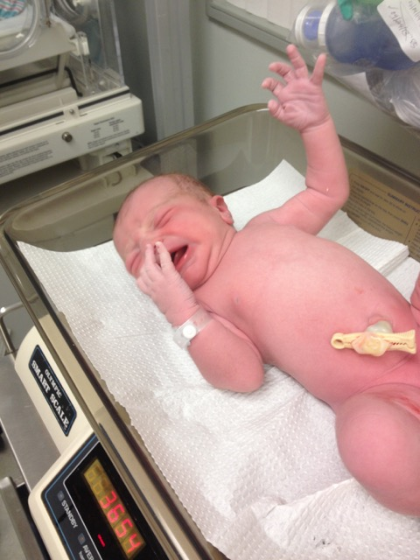
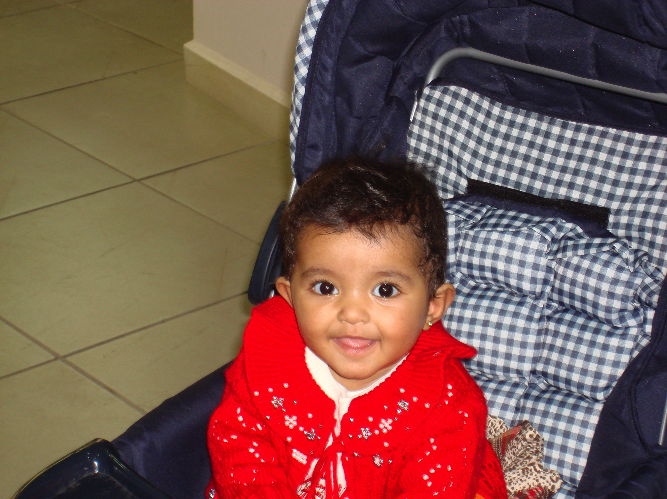
She is documented as the first case of Embryo biopsy and PGD in RFC.

Slide 17
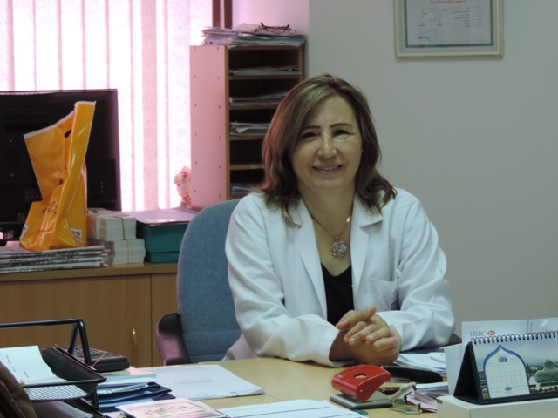
Dr. Mousa was involved in many infertility societies executive boards in the past.

Slide 18
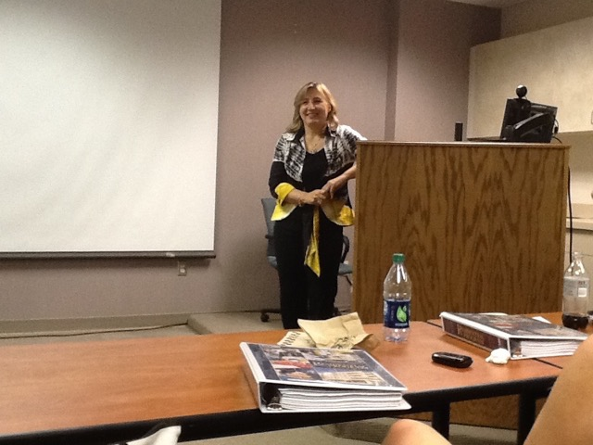
Dr. Mousa is a previous professor of Obstetrics and Gynecology in ‘Albaath University”.

Slide 19
Rafif Mousa, MD, MSc
American Fertility Center.
medical director
Irvine CA.
USA

